Slide 1
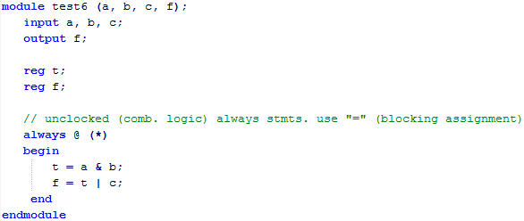
“t” and “f” still declared as reg even though they’re used inside a comb. logic always stmt.
specifies combinational logic (unclocked) always stmt.
should use “=“ (called “blocking” assignment) in comb. logic always statements. RHS just takes output from the previous equation.
takes output of “t” from previous equation

Slide 2
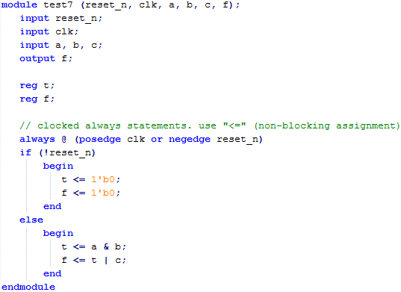
“t” and “f” still declared as reg as they’re used inside an always statement (clocked always in this case)
specifies clocked always statement with positive edge triggered flip-flops with negative reset.
this if part specifies how the registers should be initialized
this else part specifies how registers should be updated at each cycle.
all “outputs” (LHS) are stored in a register in a clocked always stmt. LHS specifies “new” value that will be stored after next clk tick.
should use “<=“ (called non-blocking assignment) instead of “=“, which means on the RHS, the value is the “current” value of the register.
LHS goes into FF
RHS taken from FF output

Slide 3
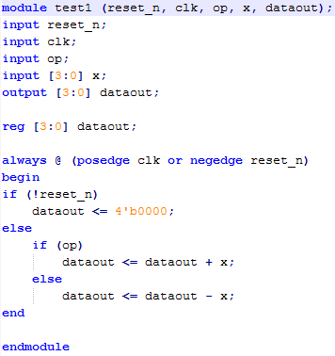
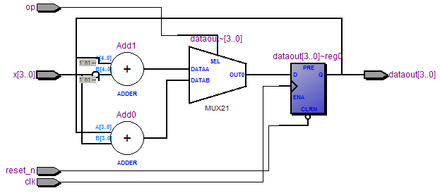
any variable written to in an always stmt must be declared as a reg, incl. outputs
clocked always stmt
this if part specifies how the registers should be initialized
this else part specifies how registers should be updated at each cycle.
all “outputs” (LHS) are stored in a register in a clocked always stmt. LHS specifies “new” value that will be stored after next clk tick.
should use “<=“ instead of “=“, which means on the RHS, the value is the “current” value of the register.
If-then-else & case stmts translated as MUXes
Arithmetic operators (e.g. “+”) are replaced with library logic implementations.
all “outputs” (LHS) are stored in a register in a clocked always stmt.

Slide 4
writes to “z” reg
reads from “z” reg
here, “y” is an “output” of this clocked always stmt, so it is stored in a register.
“<=“ should be used, which means on the RHS, “y” is the current value of the register, and on the LHS, “y <= …” is the new value that will be stored in the register on the next clk tick.
“x” is an external input to this clocked always stmt, so it’s not register.
1st always stmt
2nd always stmt
writes to “z” reg
output from clocked always stmt is output of reg.
reads from “z” reg

Slide 5
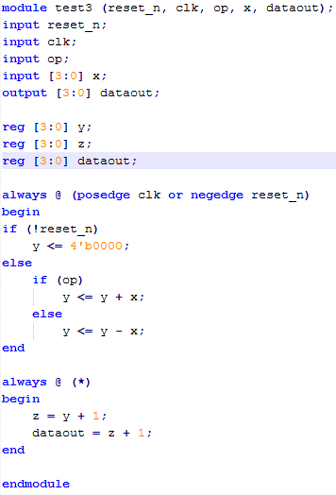
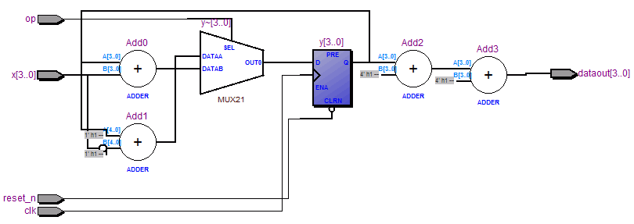
specifies combinational logic (unclocked) always stmt.
should use “=“ in comb. logic always stmts. no reg. RHS just takes output from the previous eqn.
“z” still declared as a reg even though it’s used inside a comb. logic always stmt.
1st always stmt
2nd always stmt
takes most recent value of “z”

Slide 6
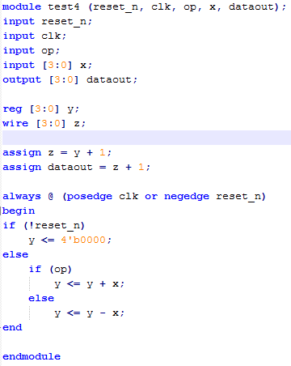
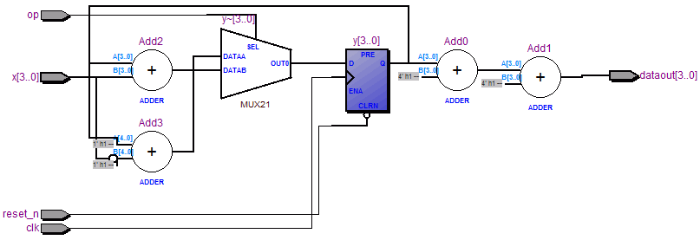
“z” should be declared as a wire when used outside of an always stmt.
note order of assign and always stmts does not matter.
always stmt
the 2 assign stmts
takes most recent value of “z”

Slide 7
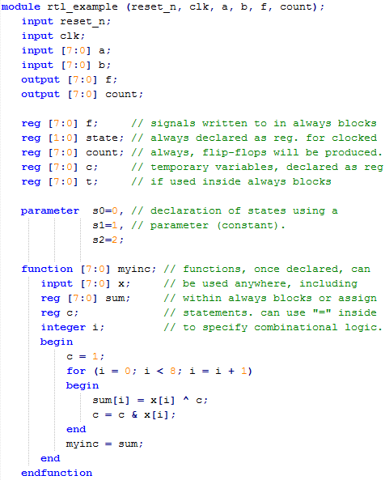
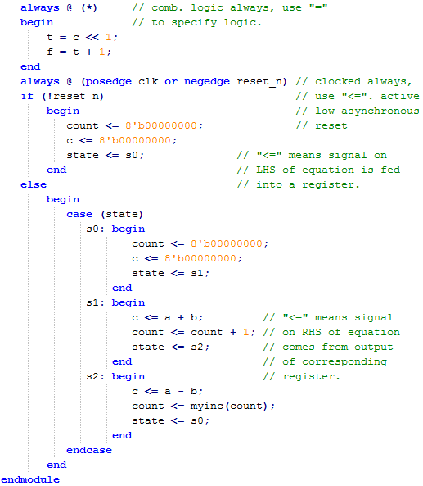

Slide 8
reset_n
clk
module rtl_example
clocked always block
logic always block
c
a
+
0
00
01
10
11
c
t
8
<<1
+1
f
–
8
8
8
b
8
count
0
00
01
10
11
+1
count
myinc
8
s1
00
01
10
11
state
s2
state
s0
2

